Slide 1
DATA WAREHOUSING
By
Syed Bakhtawar Shah Abid
Assistant Professor
Department of Computer Science
Data Warehousing

Slide 2
Conceptual Modeling of Data Warehouses
Modeling data warehouses: dimensions & measures
  Star schema: A fact table in the middle connected to a set of dimension tables
  Snowflake schema: A refinement of star schema where some dimensional hierarchy is normalized into a set of smaller dimension tables, forming a shape similar to snowflake
  Fact constellations: Multiple fact tables share dimension tables, viewed as a collection of stars, therefore called galaxy schema or fact constellation
Data Warehousing

Slide 3
STAR SCHEMA
The star schema gets its name from the physical model's resemblance to a star with a fact table at its center and the dimension tables surrounding it representing the star's points.
In computing, the Star Schema (also called star-join schema) is the simplest style of data mart schema.
The star schema consists of one or more fact tables referencing any number of dimension tables.
Data Warehousing

Slide 4
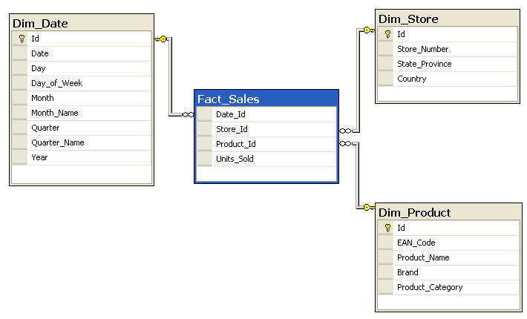
STAR SCHEMA
Data Warehousing

Slide 5
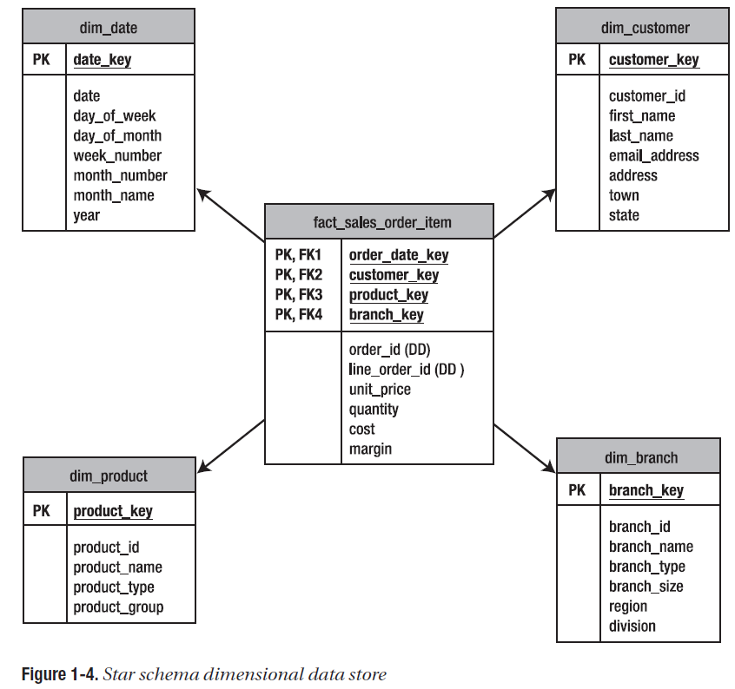
STAR SCHEMA
Data Warehousing

Slide 6
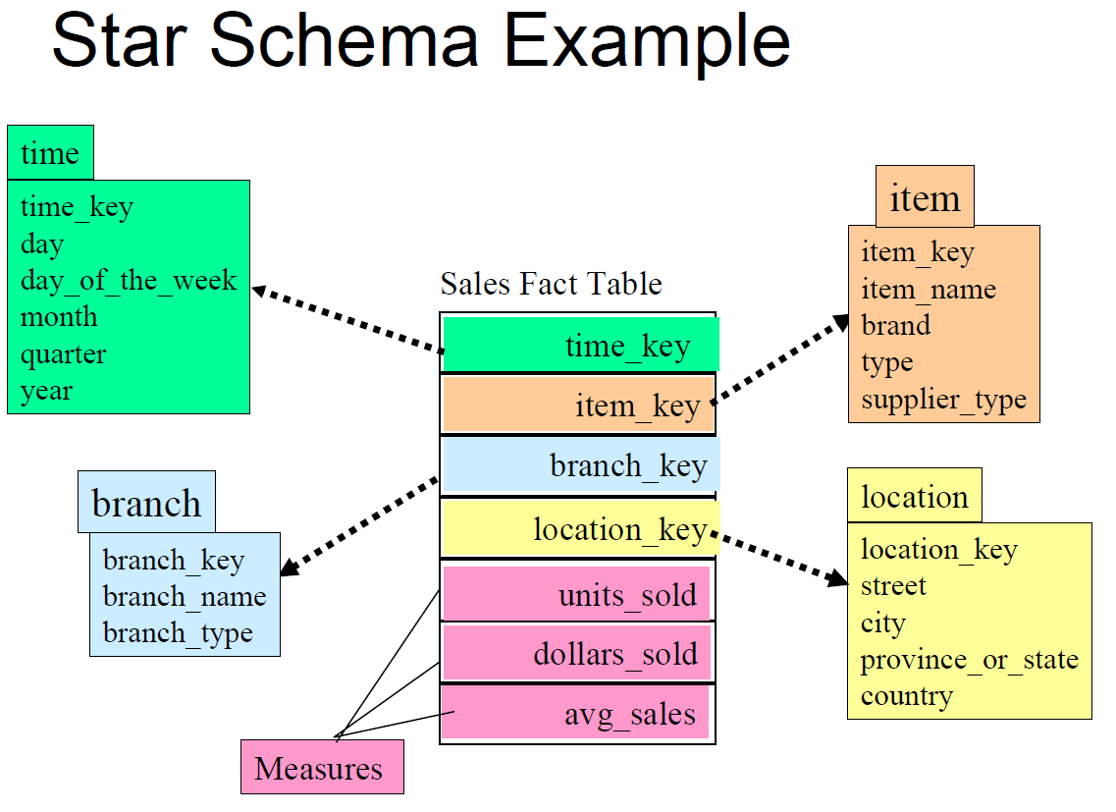

STAR SCHEMA
Data Warehousing

Slide 7
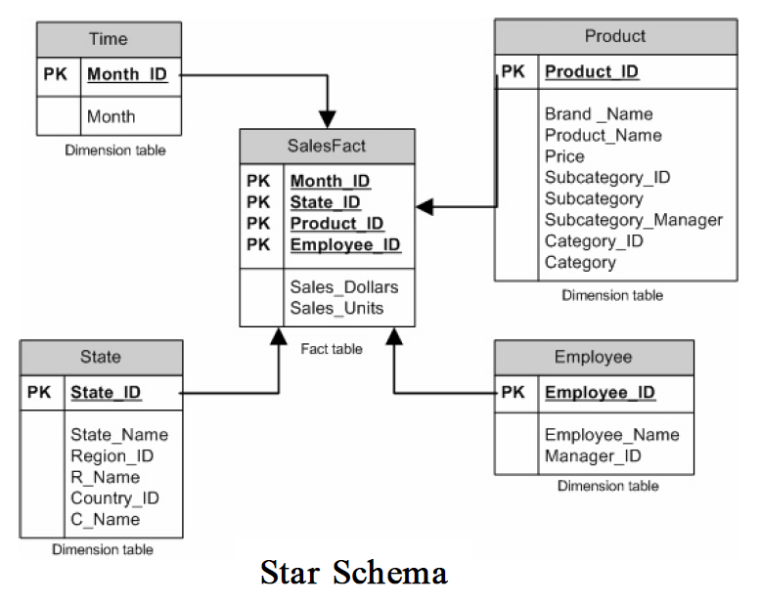
STAR SCHEMA
Data Warehousing

Slide 8
SNOWFLAKE SCHEMA
A snowflake schema is a logical arrangement of tables in a MDB such that the entity relationship diagram resembles a snowflake shape.
The snowflake schema is represented by centralized fact tables which are connected to multiple dimensions.
In a snowflake schema, a dimension can have a sub-dimension.
The purpose of having a sub-dimension is to minimize redundant data.
Data Warehousing

Slide 9
SNOWFLAKE SCHEMA
"Snowflaking" is a method of normalizing the dimension tables in a star schema.
When it is completely normalized along all the dimension tables, the resultant structure resembles a snowflake with the fact table in the middle.
Data Warehousing

Slide 10
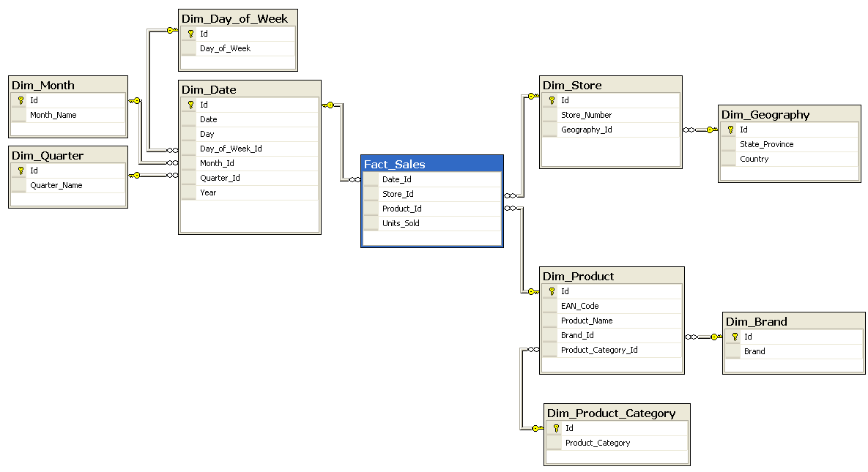
SNOWFLAKE SCHEMA
Data Warehousing

Slide 11
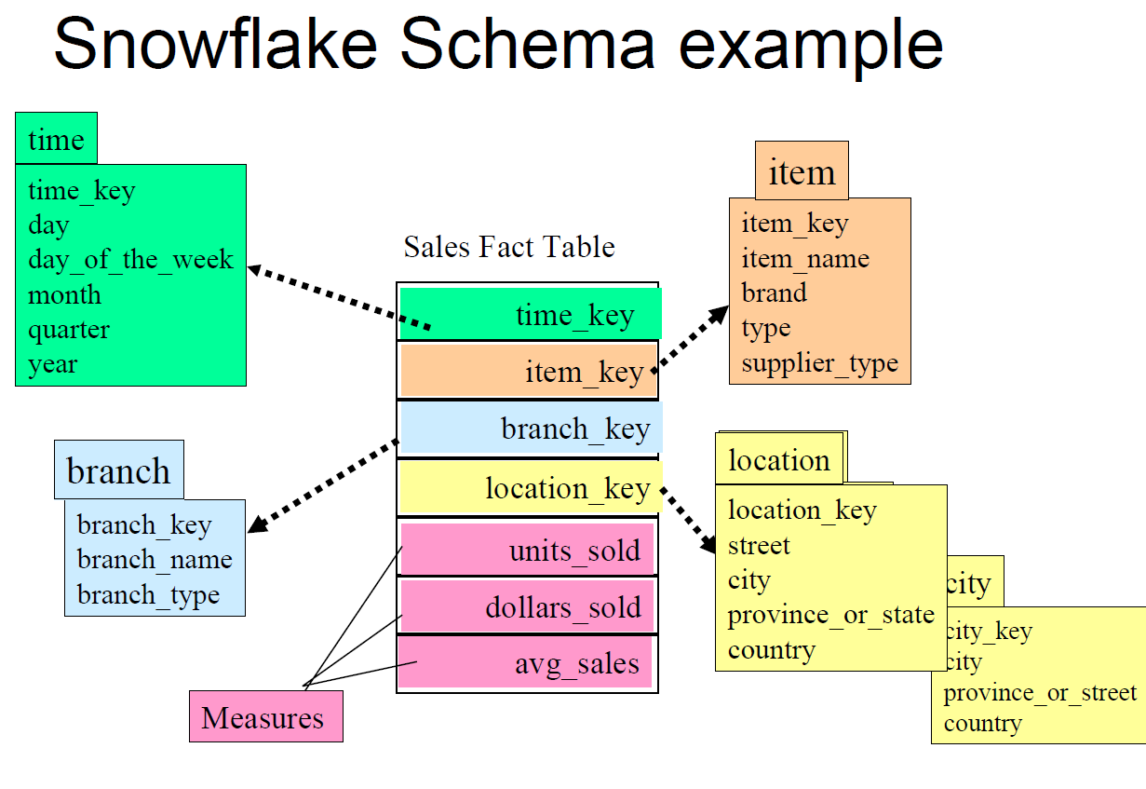
SNOWFLAKE SCHEMA
Data Warehousing

Slide 12
GALAXY SCHEMA
A galaxy schema is also known as a fact constellation schema
Galaxy schema is a schema where multiple fact tables share dimension tables.
The benefit of galaxy schema is the ability to model the business events more accurately by using several fact tables
Data Warehousing

Slide 13
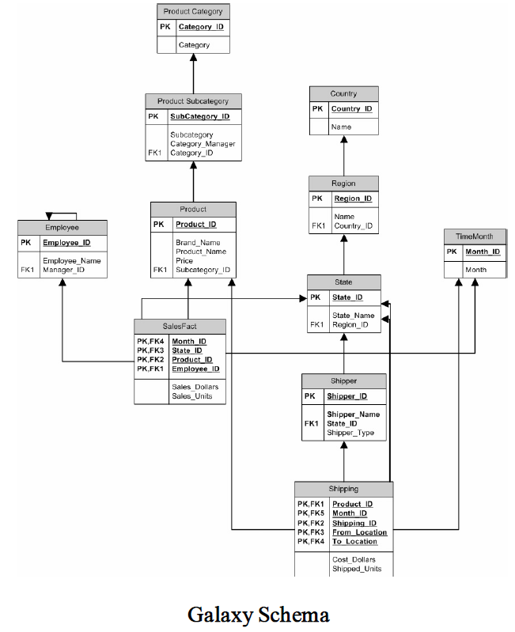
Data Warehousing

Slide 14
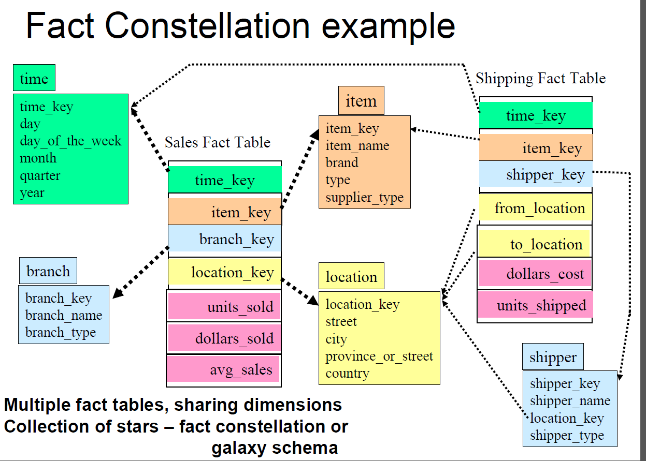
GALAXY SCHEMA
Data Warehousing

Slide 15
Data Modeling
Data Warehousing

Slide 16
Data Warehousing Process (Paulraj)
Data mart, bottom up, the Kimball methodology
Enterprise-wide warehouse, top down, the Inmon methodology
When properly executed, both result in an enterprise-wide data warehouse
Data Warehousing

Slide 17
The Data Mart Strategy
The most common approach
Begins with a single mart and architected marts are added over time for more subject areas
Relatively inexpensive and easy to implement
Can be used as a proof of concept for data warehousing
Requires an overall integration plan
Data Warehousing

Slide 18
The Enterprise-wide Strategy
A comprehensive warehouse is built initially
Like all complex projects, it is expensive, time consuming, and prone to failure
When successful, it results in an integrated, scalable warehouse
Data Warehousing

Slide 19
From Requirements to Data Design
Data Warehousing

Slide 20
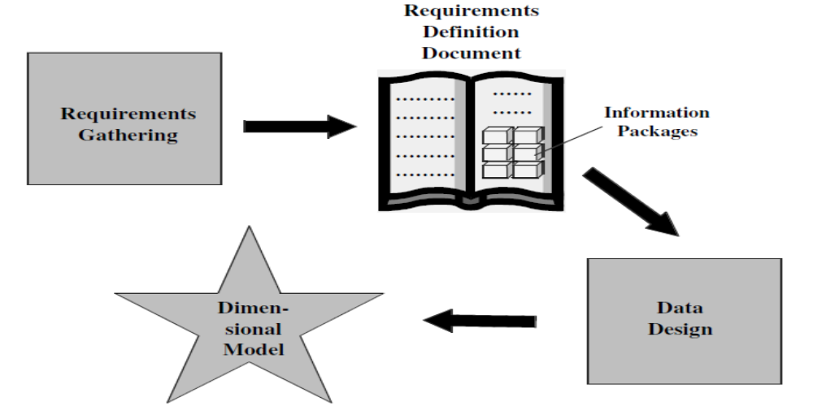
From Requirements to Data Design (Paulraj)
Data Warehousing

Slide 21
Design Decisions
Before we proceed with designing the dimensional data model, let us quickly review some of the design decisions we have to make:
Choosing the process.
  Selecting the subjects from the information packages for the first set of logical structures to be designed.
Choosing the grain.
  Determining the level of detail for the data in the data structures.
Grain is also termed as the unit of analysis
  Typical grains
    Individual Transactions
      Individual customer’s transaction at a retail store
      Student enrolled in a course
    Daily aggregates
      Daily snapshot of inventory level for a product in a warehouse
    Monthly aggregates
      Monthly measures of a sales office
Data Warehousing

Slide 22
Design Decisions
Identifying and conforming the dimensions.
  Choosing the business dimensions (such as product, market, time, etc.) to be included in the first set of structures and making sure that each particular data element in every business dimension is conformed to one another.
Choosing the facts.
  Selecting the metrics or units of measurements (such as product sale units, dollar sales, dollar revenue, etc.) to be included in the first set of structures.
Choosing the duration of the database.
  Determining how far back in time you should go for historical data.
Data Warehousing

